Slide 1

Economics and Computation in Decentralized Systems
Matheus Venturyne Xavier Ferreira
Princeton University
Microsoft Research
March 10, 2021

Slide 2
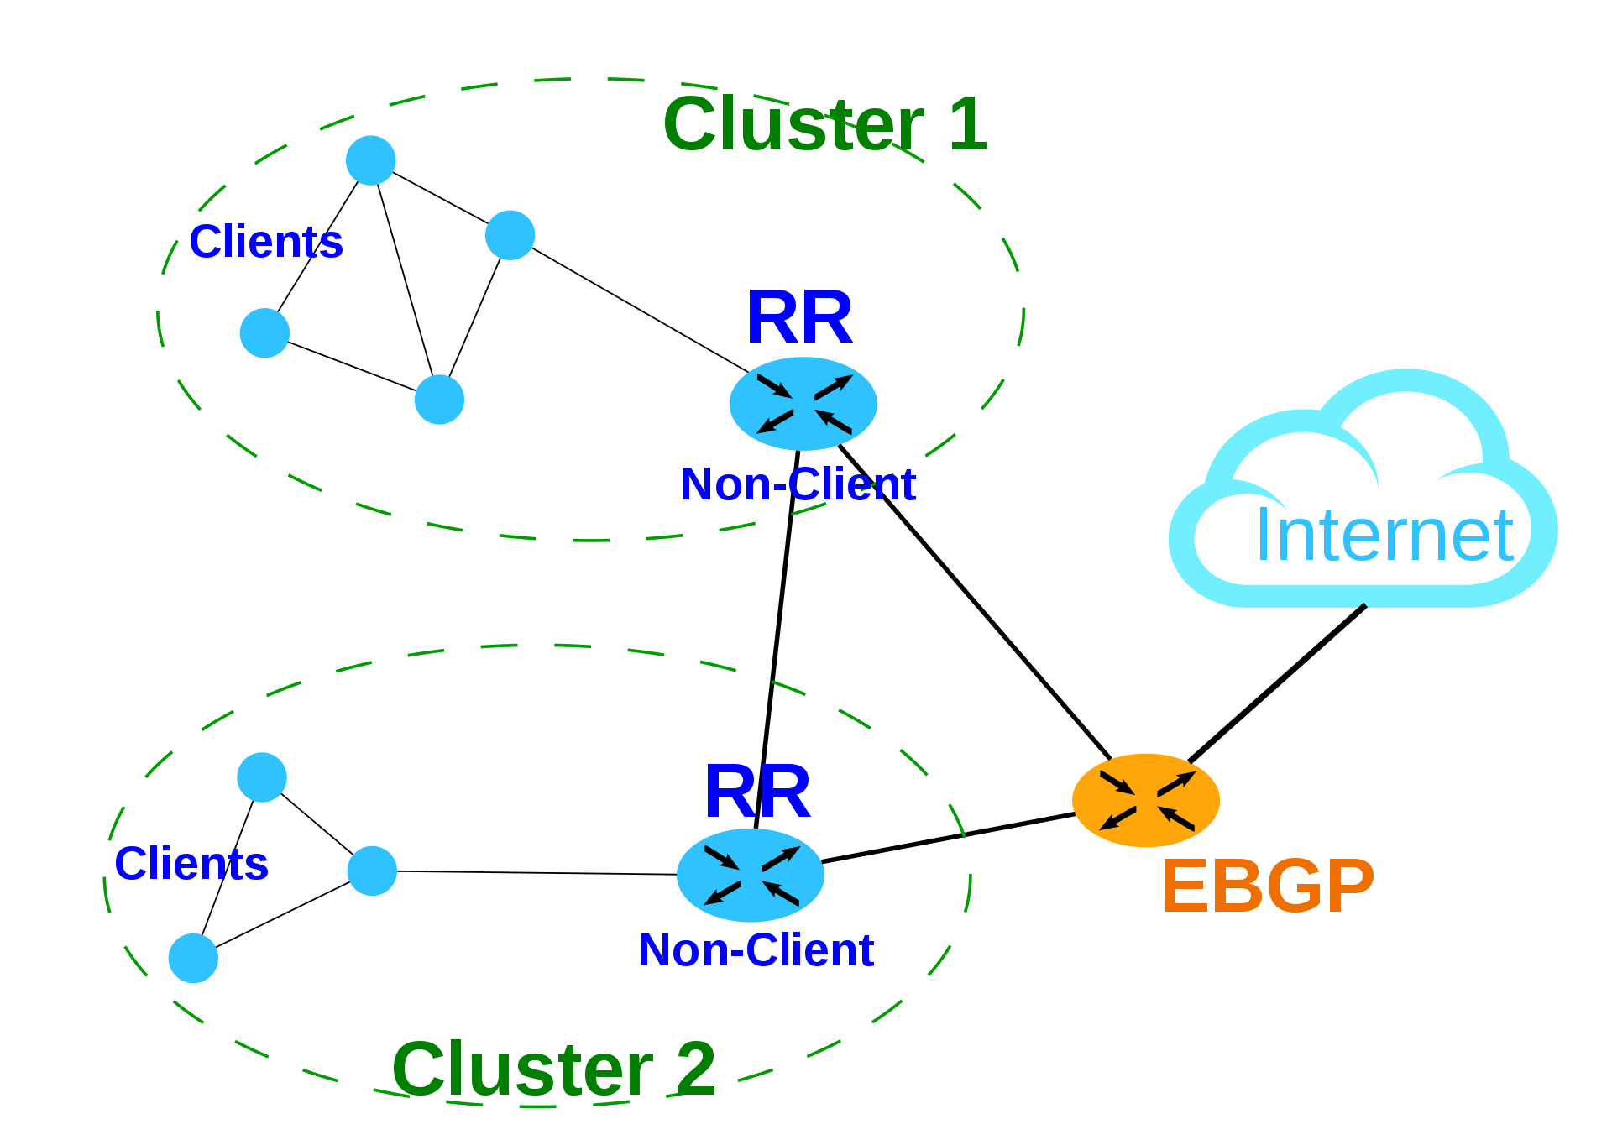


Economics and Computation
Many computer science applications require economic reasoning
Source: Public Auction Finder
Source: Equity Trust
Online Markets
Internet routing
Blockchains
Auctions: eBay.
Sharing economy: Uber, Lift, Airbnb.
Advertisement: Bing, Google, Facebook.
Network formation: BGP.
Congestion games.
Cryptocurrencies: Bitcoin, Ethereum.
Decentralized applications in finance, healthcare, supply-chain, …
Notes:
In the past twenty years, economic reasoning has been important to the reason about many internet applications.
That includes online auctions like eBay which popularized second-price auctions from auction theory. In ride sharing, drivers obviously have interest in their outcomes and platforms like Uber and Lift has to carefully consider their economic incentives.
Additionally, online advertising is still the biggest source of revenue for many Internet companies.
Economic reasoning is important to model how the internet itself is structured. Internet Service Provides have the flexibility to decide how they route data in the internet. Their decisions are driven by economic reasoning.
More recently blockchains promise to be disruptive in many applications domains but requires very careful economic reasoning. Blockchains are already disruptive in cross border payments by significantly reducing the cost for international money transfers.
In this talk, will focus on economic incentives in online auctions and public blockchains.

Slide 3
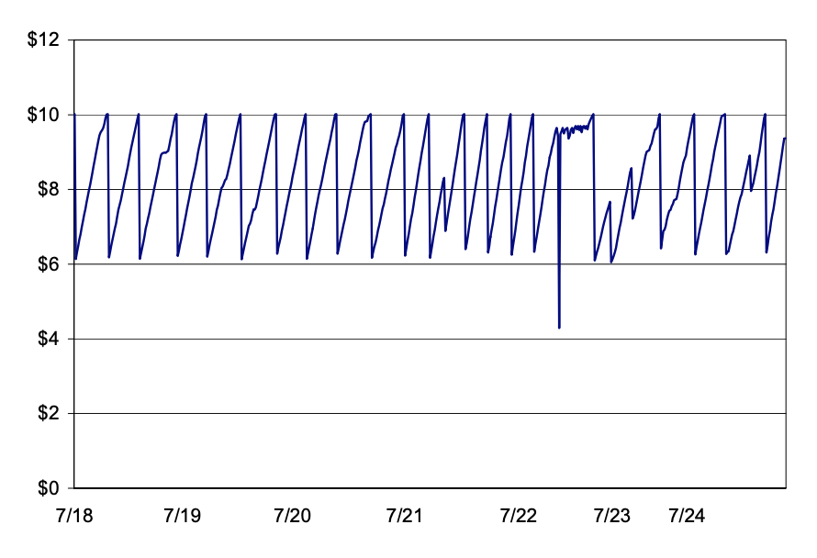
Early days of sponsored search
Strategic bidding caused instability in first-price auctions.
1 week
Instability in Overture auctions [Edelman, Ostrovsky ‘07]
Notes:
In the early days of online advertising, first-price auctions were the predominant mechanism. However, first-price auctions are well-known for not converging to an stable equilibrium. Specially when you had automatic bidding software participate on this auctions, they would show cyclic patterns.
This instability creates inefficiencies and loss of revenue.

Slide 4
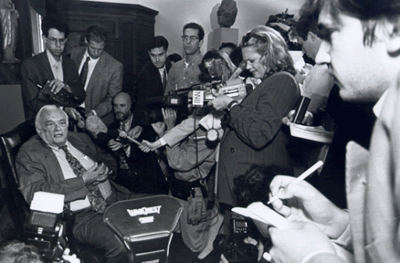
The Internet popularized second-price auctions
[Vickrey ‘61] Second-price auctions.
Auctioneer collects bids privately.
Winner pays the second highest bid.
Alice
Second-Price Auction
Bob
Bid $80
Bid $20
Vickrey. Awarded the ‘96 Nobel prize in economics.
Pay $20
Notes:
Because of this limitation of first-price auctions in online advertising, the internet popularized second-price auctions.

Slide 5

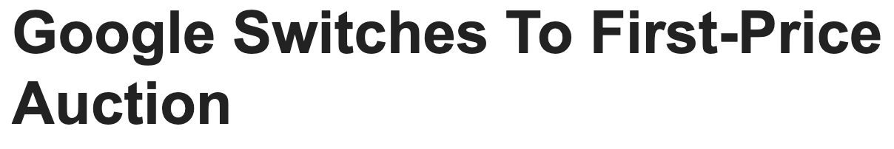
The return of first-price auctions
Date: March 6th, 2019
What went wrong???

Slide 6

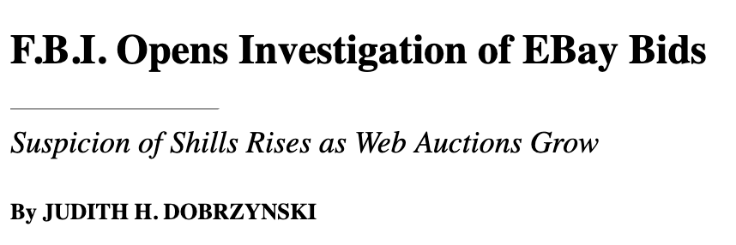

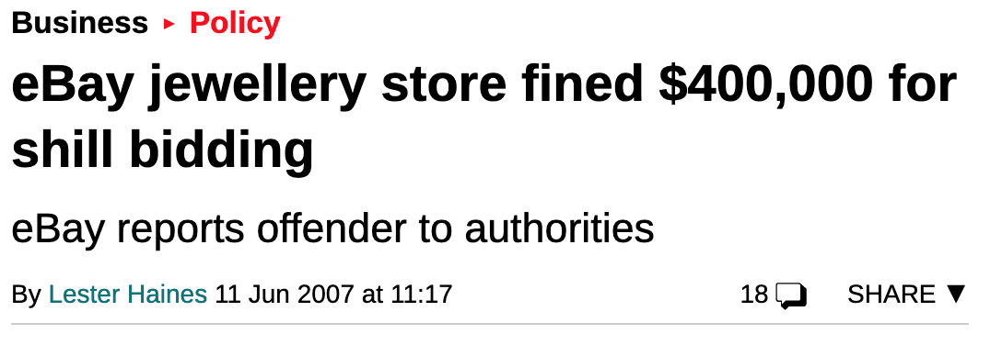

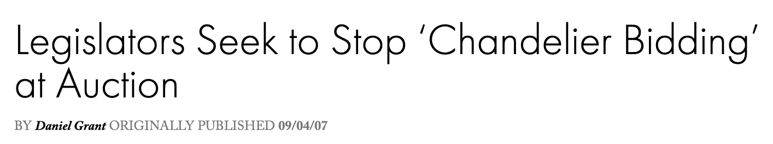
Algorithm designer as an adversary
Alice
Second-Price Auction
Bob
Bid $80
Bid $20
Pay $79

Slide 7

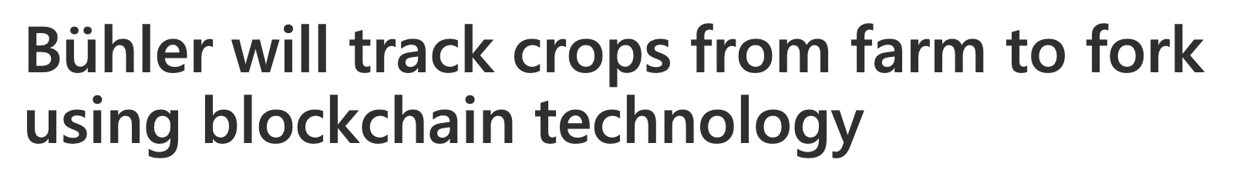

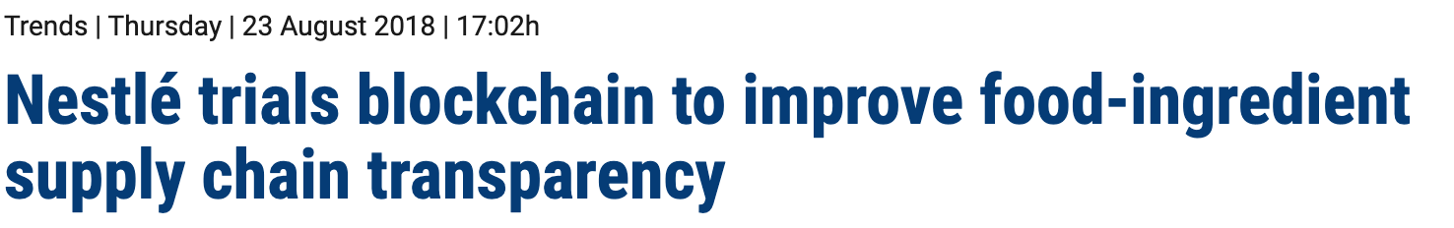
Desire for transparency is a universal concern
Blockchains enable decentralization and overcome market barrier.
Removal of intermediaries.
Diverse application domain: healthcare, supply chain, finance, e-commerce, …
Çağlayan Arkan, September, ‘18

Slide 8

Research Question
How can we design algorithms when the algorithm designer is an economically driven adversary?
To instantiate this agenda:
Credible auctions.
Incentive compatible energy-efficient blockchains.

Slide 9
Credible Auctions
Desiderata:
Incentive compatible for bidders.
Incentive compatible for the auctioneer (Credible).
Revenue optimal
[Akbarpour and Li ‘20] The ascending price auction IS THE UNIQUE auction that satisfy all this properties.
BUT the communication complexity is unbounded!
Main Question. Can we introduce additional assumptions to circumvent their impossibility?
Alice
Second-Price Auction
Bid $80
Pay $79

Slide 10
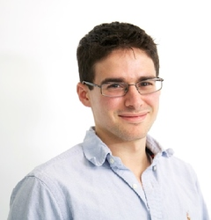

Credible, Truthful, Two-Round Optimal Auctions via Cryptographic commitments [FW ‘20]
Under standard cryptographic assumptions, there is an auction that is:
Incentive compatible for bidders.
Incentive compatible for the auctioneer (Credible).
Revenue optimal.
AND requires only two rounds of communication.
Matt Weinberg

Slide 11
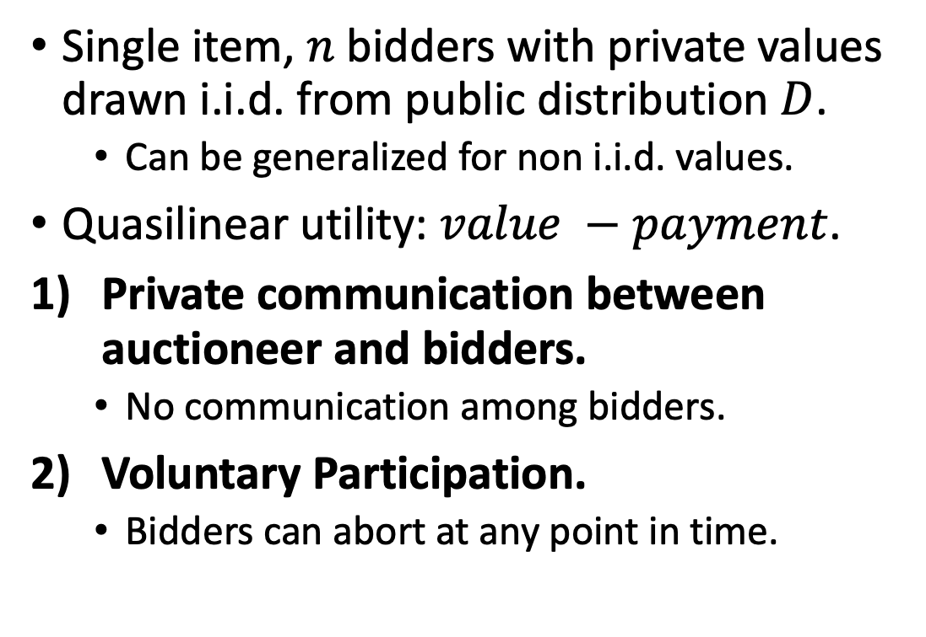
Model
Single item, $n$ bidders with private values drawn i.i.d. from public distribution $D$.
Can be generalized for non i.i.d. values.
Quasilinear utility: $value −payment$.
Private communication between auctioneer and bidders.
No communication among bidders.
Voluntary Participation.
Bidders can abort at any point in time.
Alice
Auctioneer
Bob
Charlie
Notes:
Let’s introduce the communication model:
The auctioneer communicates privately with bidders.
There is no communication among bidders.
Bidders can leave at any point. A bidder cannot be forced to participate in the game.
Only the auctioneer knows the number of bidders. So the auctioneer can introduce as many fake bidders as he wishes.

Slide 12
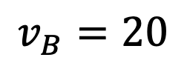
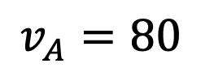
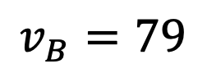
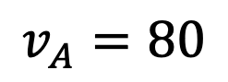
Safe Deviations [Akbarpour and Li ‘20]
The auctioneer publicly ‘’promises’’ to implement an auction format.
A deviation from the promised auction is safe if for all bidders, the outcome of the auction is always consistent with some realization of the auction.
$$v_{A}=80$$
Consistent with
$$v_{A}=80$$
Alice
Alice
Second-Price Auction
Second-Price Auction
$$v_{B}=20$$
$$v_{B}=79$$
Pay 79
Pay 79
Bob
Bob
Notes:
Before we define credible auctions, we need to define the concept of a safe deviation for the auctioneer introduced in Akbarpour and Li.
Define safe deviation and give example

Slide 13
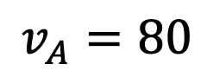
Credible Auction
No safe deviation from the promised auction yields more revenue than implementing the promised auction in earnest.
$$v_{A}=80$$
First-Price Auction
Alice
Pay 80!
Notes:
Define credible and give example of first price auction.
- The auctioneer cannot improve revenue but not giving the item to the highest bidder and the highest bidder can only be charged her value.

Slide 14
Deferred Revelation Auction (DRA)

Slide 15
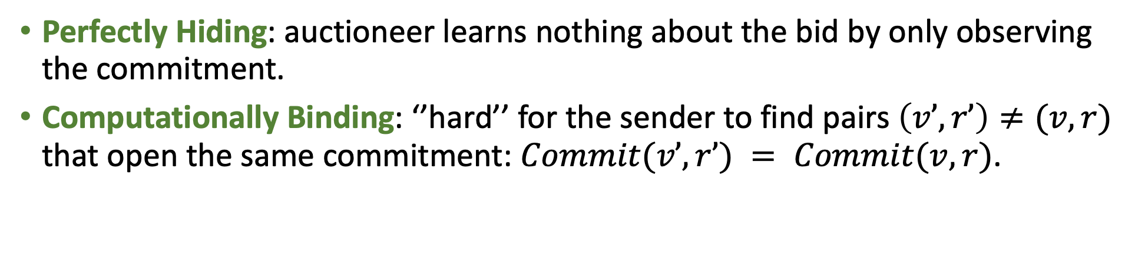
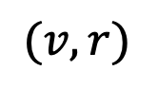
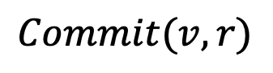
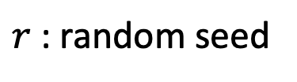
Cryptographic Commitments
$r$: random seed
$$Commit(v, r)$$
Auctioneer
Alice
$(v, r)$
Perfectly Hiding: auctioneer learns nothing about the bid by only observing the commitment.
Computationally Binding: ‘’hard’’ for the sender to find pairs $\left(v’, r’\right)≠(v, r)$ that open the same commitment: $Commit(v’, r’) = Commit(v, r)$.

Slide 16
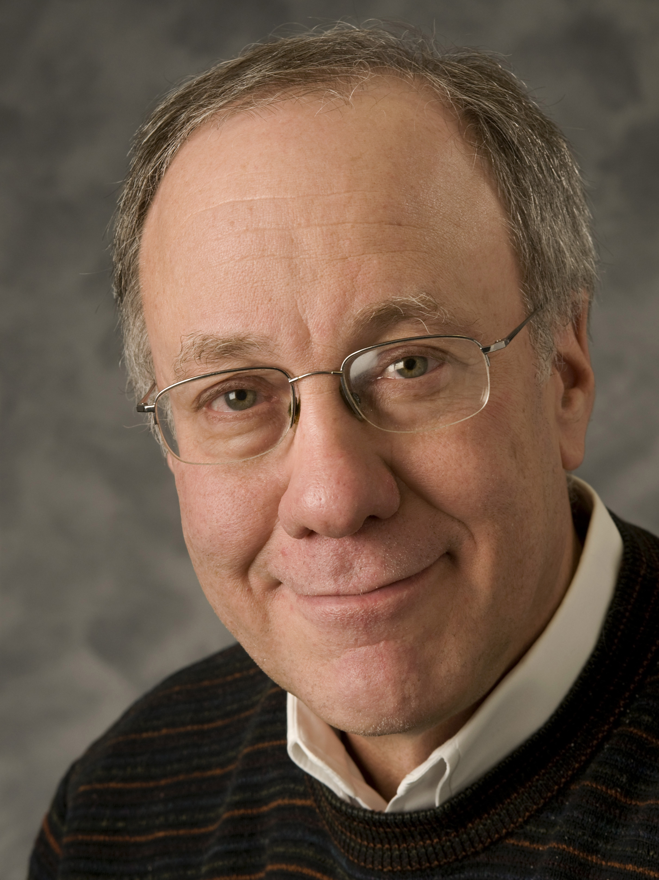
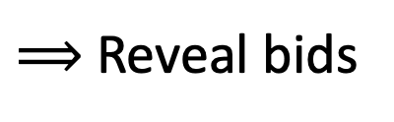
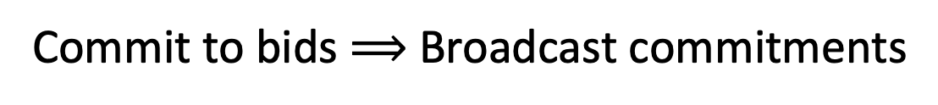
First Attempt
Commit to bids $⟹$ Broadcast commitments
$⟹$Reveal bids
$⟹$Second-price auction with optimal reserve $r(D)$ [Myerson, ‘81]
Auctioneer
Alice
Commit to $80
Commit to $90
Reveal $80
Myerson. Awarded the ’07 Nobel prize in economics
Reveal $90

Slide 17
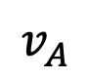
Sybil Attack
There is no cost to submit fake bids.
AND there is no cost for aborting fake bidders.
Remark: off-the-shelf secure multi-party computation gives no guarantees against sybil attacks.
Fake Bidders
$$v_{A}$$
1
2
…
77
78
79
80
81
82
…
98
99
Reveal
Conceal

Slide 18
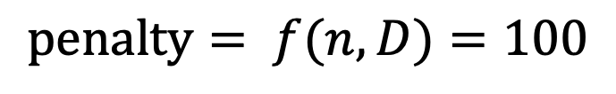
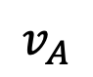
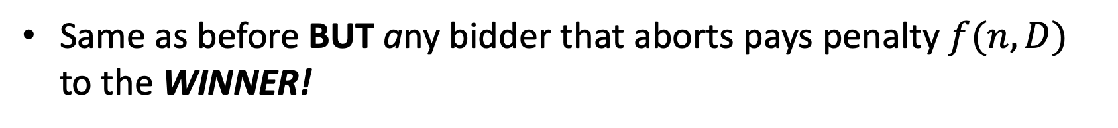
One new idea
Same as before BUT any bidder that aborts pays penalty $f(n, D)$ to the WINNER!
Fake Bidders
$$penalty= f(n, D)=100$$
$$v_{A}$$
1
2
…
77
78
79
80
81
82
…
98
99

Slide 19
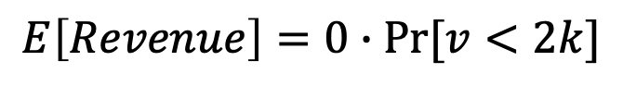
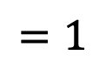
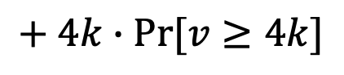
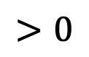
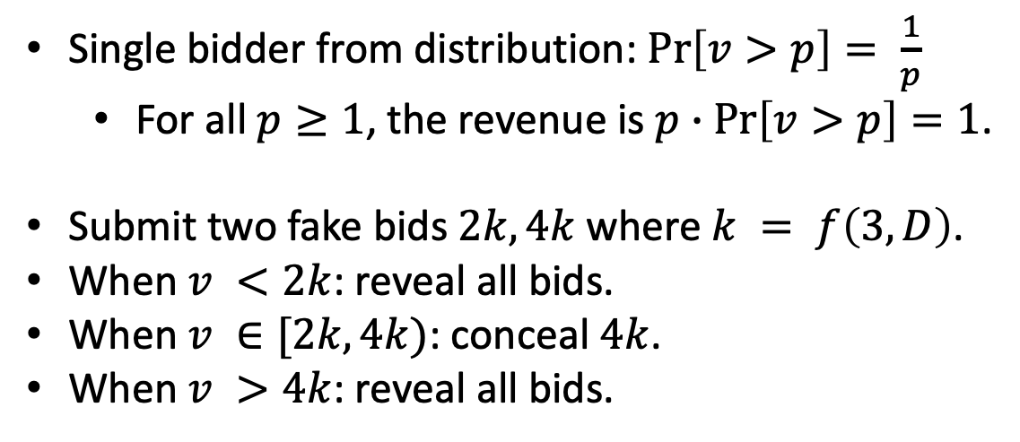
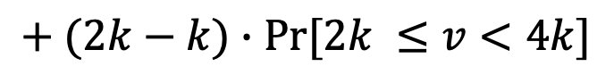
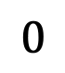
A sufficiently large penalty might not exist
Single bidder from distribution: $\operatorname{Pr}\left[v>p\right]= \frac{1}{p}$
For all $p≥1$, the revenue is $p∙\operatorname{Pr}\left[v>p\right]=1$.
Submit two fake bids$2k, 4k$ where $k = f\left(3, D\right)$.
When $v <2k$: reveal all bids.
When $v ∈[2k, 4k)$: conceal $4k$.
When $v >4k$: reveal all bids.
Alice
$$E\left[Revenue\right]=0∙Pr⁡[v<2k]$$
$$+ (2k−k)∙Pr⁡[2k ≤v<4k]$$
$$+ 4k∙Pr⁡[v≥4k]$$
$$0$$
$$>0$$
$$=1$$

Slide 20
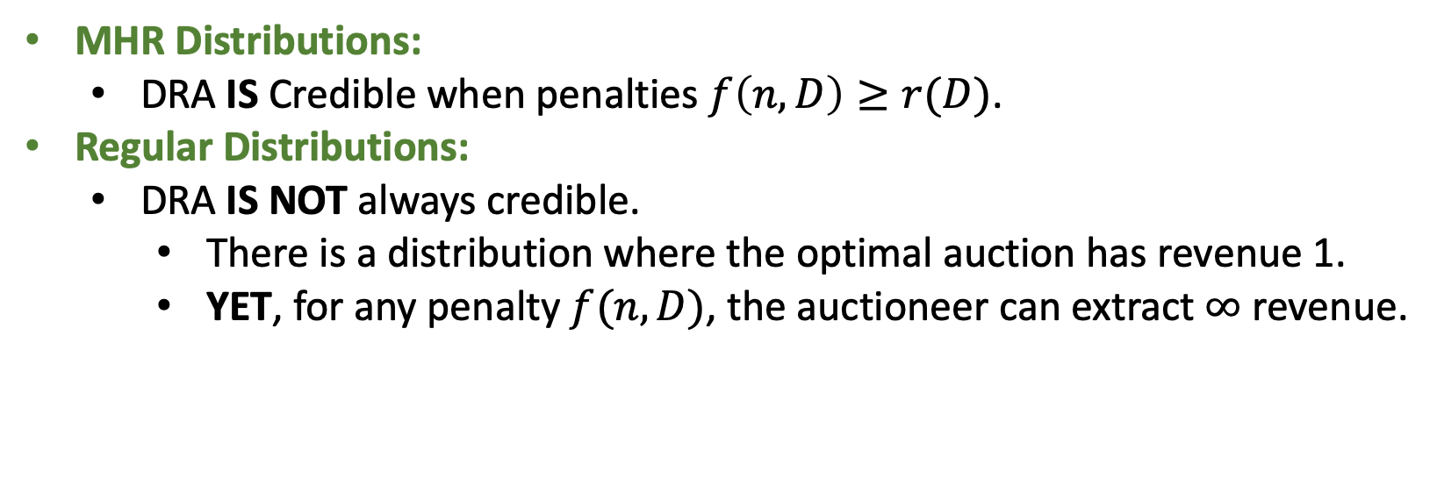
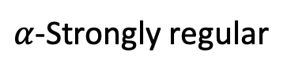
Main results
optimal reserve price
MHR Distributions:
DRA IS Credible when penalties $f\left(n, D\right)≥r(D)$.
Regular Distributions:
DRA IS NOT always credible.
There is a distribution where the optimal auction has revenue 1.
YET, for any penalty $f(n, D)$, the auctioneer can extract $∞$ revenue.
MHR
Regular
$α$-Strongly regular
Approximately credible

Slide 21

Outline
Communication-efficient credible auctions.
Incentive compatible energy-efficient blockchains.
Conclusion.

Slide 22
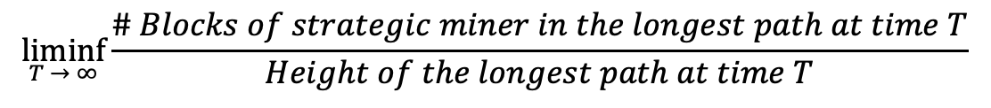
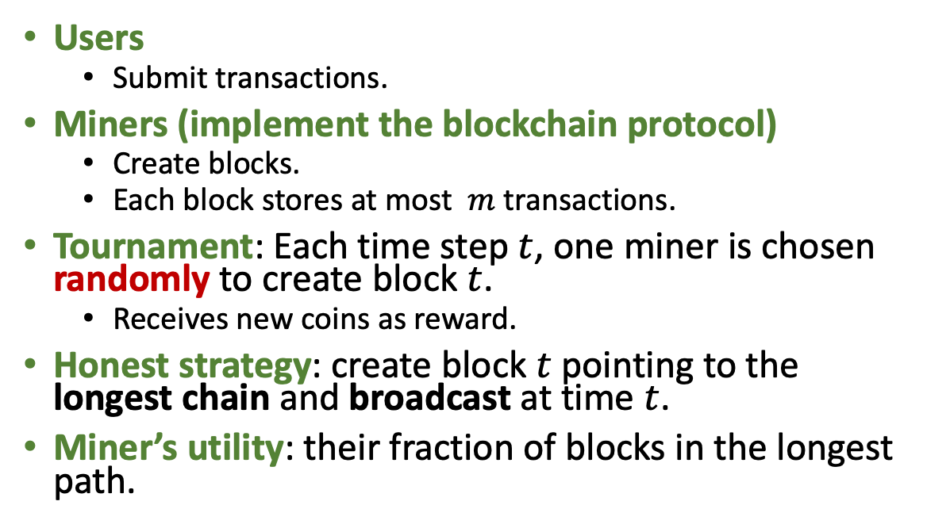
Blockchains are algorithms
0
Alice owns 1 BTC
Users
Submit transactions.
Miners (implement the blockchain protocol)
Create blocks.
Each block stores at most $m$ transactions.
Tournament: Each time step $t$, one miner is chosen randomly to create block $t$.
Receives new coins as reward.
Honest strategy: create block $t$ pointing to the longest chain and broadcast at time $t$.
Miner’s utility: their fraction of blocks in the longest path.
1
2
Alice sends 1 BTC to Charlie
3
Adversary’s block
$$\underset{T → ∞}{liminf}{\frac{\# Blocks of strategic miner in the longest path at time T}{Height of the longest path at time T}}$$

Slide 23
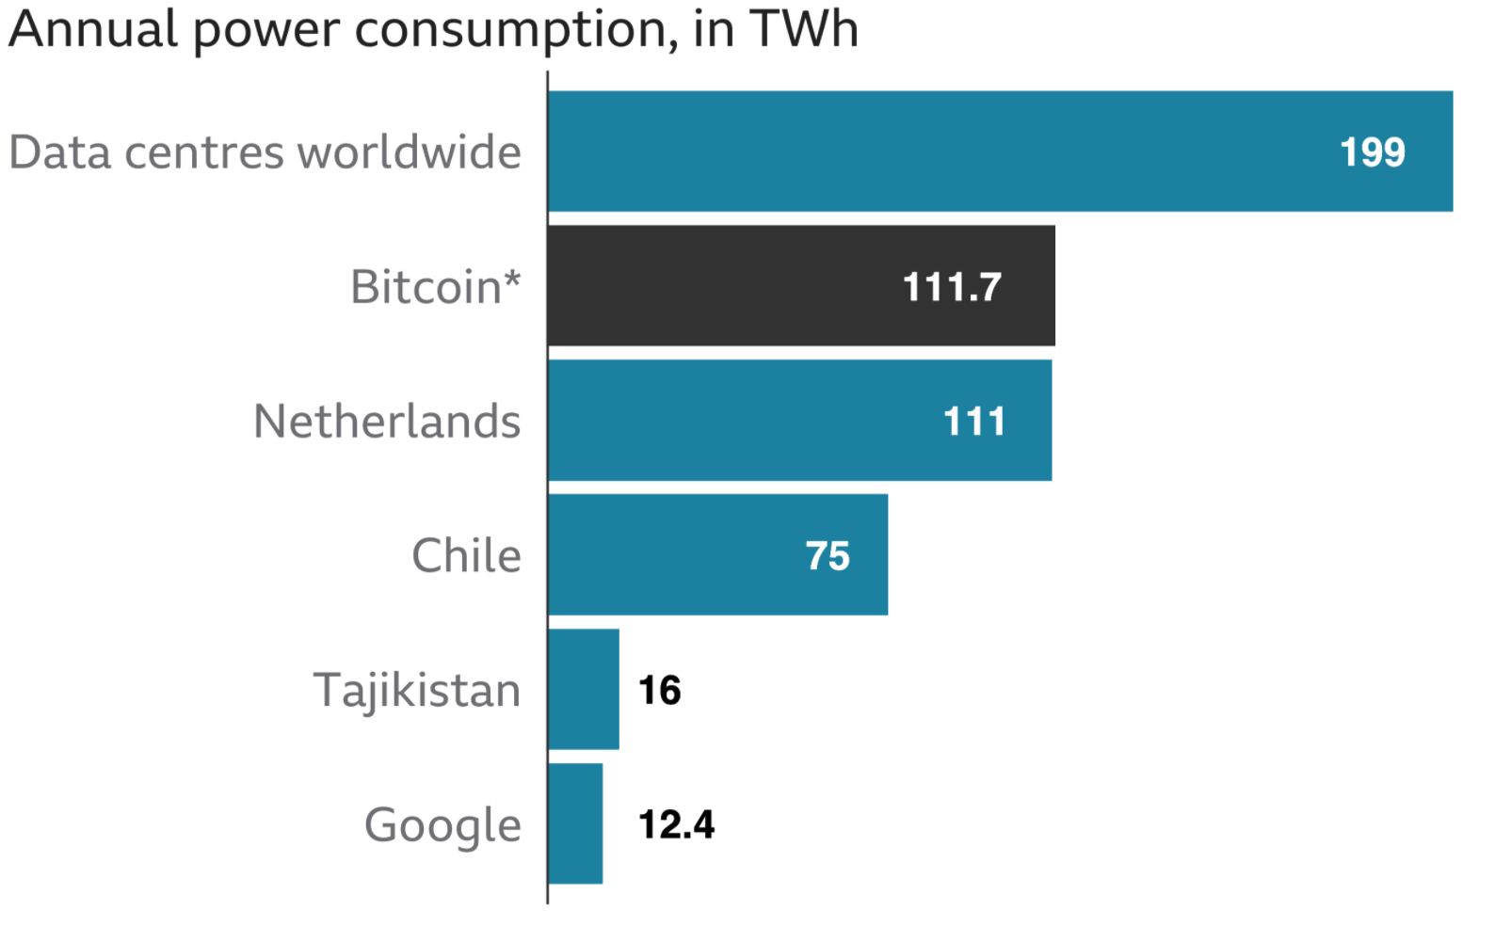
Environmental cost of Bitcoin
Bitcoin’s consensus algorithm is based on proof-of-work.
Energy intensive yet can only process 7 transactions per second.
Data centers worldwide
Source: BBC News. January 2021.
Notes:
Visa can process 65000 transactions per second

Slide 24
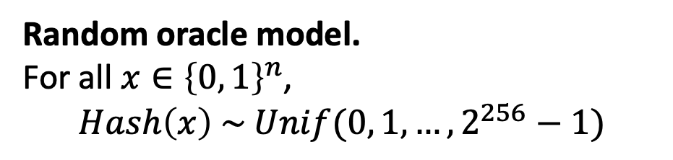
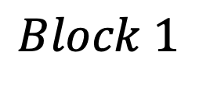
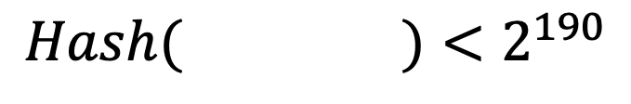
Beyond Proof-of-Work
Proof-of-work (PoW) requires miners to compete to solve a crypto puzzles:
Proof-of-stake (PoS) is an energy friendly alternative.
Tournament: sample a uniformly random coin.
Block 1 header
Random oracle model.
For all $x∈{\left\{0, 1\right\}}^{n}$,
$$Hash\left(x\right) \sim Unif(0, 1, …, 2^{256}−1)$$
Nonce
0
Hash of Block 0 header
Transaction 1
Transaction 2
…
$$Hash( )<2^{190}$$
$$Block 1$$

Slide 25
Nash equilibrium
Honest mining is a Nash equilibrium if all miners prefer to play honest mining given all other miners are playing honest mining.
Desiderata: under which conditions is honest mining a Nash equilibrium?
[Brown-Cohen, Narayanan, Psomas, Weinberg ‘18] gave a formal barrier. For any longest-chain protocols, IF
Mining is computationally efficient.
All source of pseudo-randomness comes from the blockchain itself.
THEN, Honest mining is NEVER a Nash equilibrium.
Main Question: Can we introduce additional assumptions to circumvent their impossibility result?

Slide 26
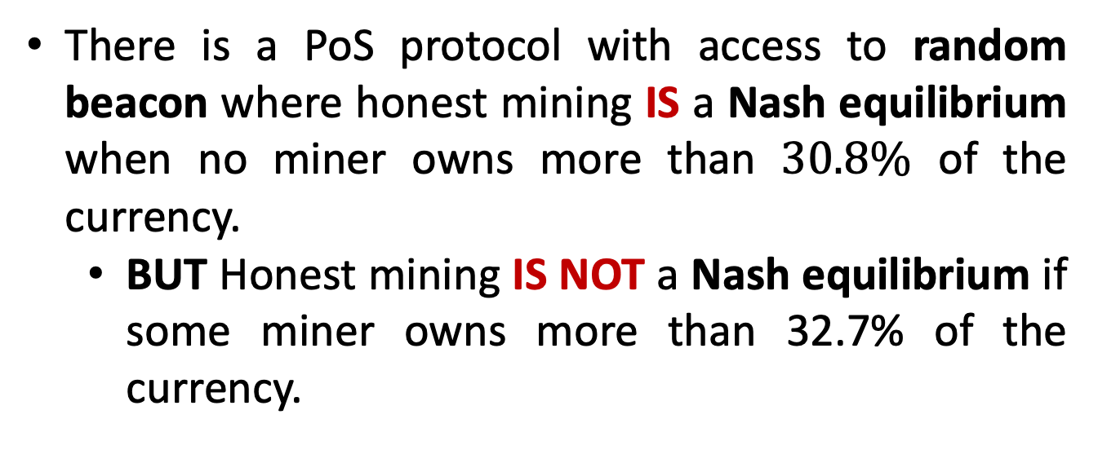
Proof-of-Stake mining games with perfect randomness [FW ‘21]
There is a PoS protocol with access to random beacon where honest mining IS a Nash equilibrium when no miner owns more than $30.8\%$ of the currency.
BUT Honest mining IS NOT a Nash equilibrium if some miner owns more than 32.7% of the currency.
Matt Weinberg

Slide 27
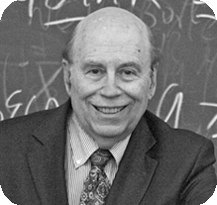
Trusted randomness in theory
Random beacons almost equivalent to common random string (CRS) from cryptography.
Except chunks of random bits are revelated in discrete time steps.
Transaction Protection by Beacons [Michal O. Rabin ‘83].
Trusted randomness allow us to do the impossible:
Non-interactive zero-knowledge proofs.
Universally composable commitments.
Incentive compatible energy-efficient blockchains.
Rabin. Awarded the ‘76 Turing award.

Slide 28
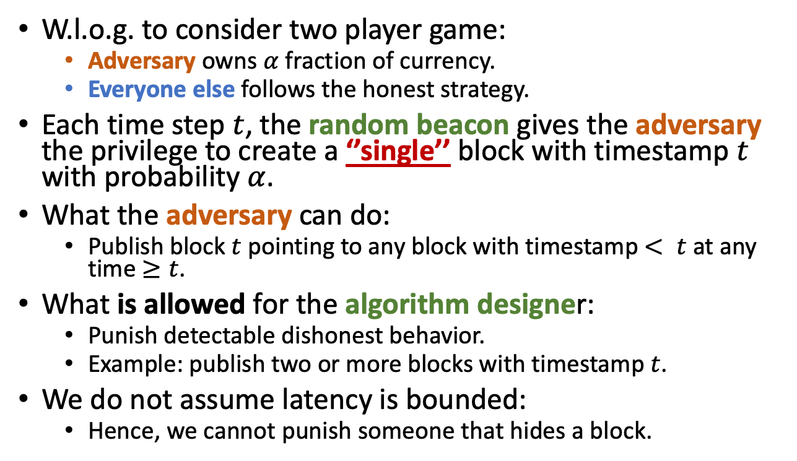
Model: PoS with random beacon
Hidden
W.l.o.g. to consider two player game:
Adversary owns $α$ fraction of currency.
Everyone else follows the honest strategy.
Each time step $t$, the random beacon gives the adversary the privilege to create a ‘’single’’ block with timestamp $t$ with probability $α$.
What the adversary can do:
Publish block $t$ pointing to any block with timestamp $< t$ at any time $≥t$.
What is allowed for the algorithm designer:
Punish detectable dishonest behavior.
Example: publish two or more blocks with timestamp $t$.
We do not assume latency is bounded:
Hence, we cannot punish someone that hides a block.
0
Public
1
2
4
3
5

Slide 29
Model: PoS with random beacon
Hidden
W.l.o.g. to consider two player game:
Adversary owns $α$ fraction of currency.
Everyone else follows the honest strategy.
Each time step $t$, the random beacon gives the adversary the privilege to create a ‘’single’’ block with timestamp $t$ with probability $α$.
What the adversary can do:
Publish block $t$ pointing to any block with timestamp $< t$ at any time $≥t$.
What is allowed for the algorithm designer:
Punish detectable dishonest behavior.
Example: publish two or more blocks with timestamp $t$.
We do not assume latency is bounded:
Hence, we cannot punish someone that hides a block.
0
Public
1
2
4
3
5

Slide 30
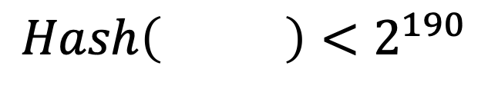
PoW games are a special case of PoS games
Proof-of-Work (PoW)
Proof-of-Stake (PoS)
0
0
A PoS protocol where block validity cannot depend on block’s content is vulnerable to Stake Grinding.
1
2
1
2
4
3
4
3
Block 5 header
Nonce
5
Hash of Block 4 header
5
$$Hash\left( \right)<2^{190}$$

Slide 31
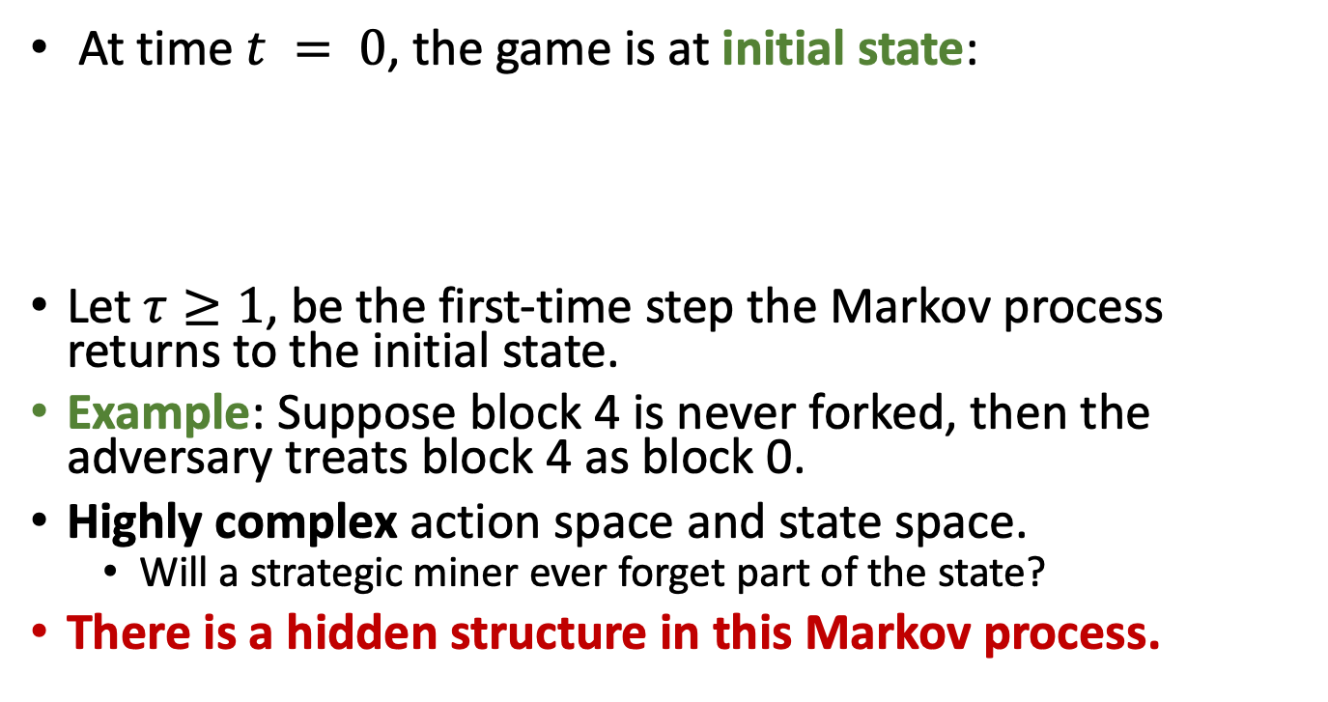
Markov decision process
0
At time $t = 0$, the game is at initial state:
Let $τ≥1$, be the first-time step the Markov process returns to the initial state.
Example: Suppose block 4 is never forked, then the adversary treats block 4 as block 0.
Highly complex action space and state space.
Will a strategic miner ever forget part of the state?
There is a hidden structure in this Markov process.
1
2
0
5
3
6
4
7

Slide 32
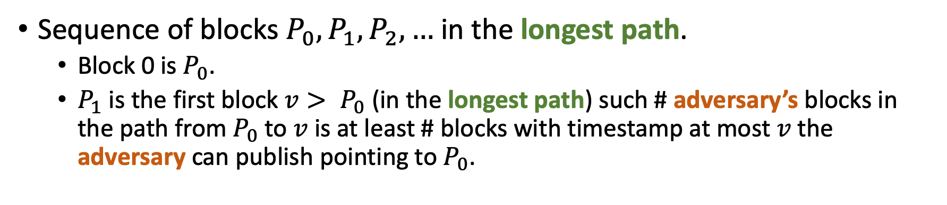
Checkpoints
Sequence of blocks $P_{0}, P_{1}, P_{2},…$ in the longest path.
Block 0 is $P_{0}$.
$P_{1}$is the first block $v> P_{0}$ (in the longest path) such # adversary’s blocks in the path from $P_{0}$ to $v$ is at least # blocks with timestamp at most $v$ the adversary can publish pointing to $P_{0}$.
Checkpoint
2
5
7
0
Checkpoint
Checkpoint
1
3
4
6
Checkpoint

Slide 33

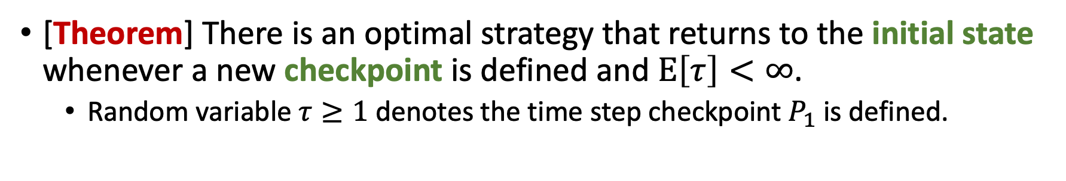
Strong Recurrence
[Theorem] There is an optimal strategy that returns to the initial state whenever a new checkpoint is defined and $E\left[τ\right]<∞$.
Random variable $τ≥1$ denotes the time step checkpoint $P_{1}$ is defined.
Checkpoint
2
5
7
0
Checkpoint
Checkpoint
1
3
4
6
Checkpoint

Slide 34
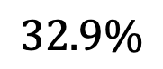

Main results
Honest mining IS a Nash equilibrium if all miners own at most $30.8\%$ of currency.
Honest mining IS NOT a Nash equilibrium if some miner owns more than $32.7\%$ of the currency.
PoS with No External Randomness
PoS Threshold
PoW Threshold
0%
30.8%
32.7%
$$32.9\%$$
[CNPW ‘18]
[SSZ ‘16]
Notes:
[SSZ, 18’] Sapirshtein, Yonatan Sompolinsky, Aviv Zohar
[CNPW, 18’] Brown-Cohen, Arvind, Alex Psomas, Weinberg

Slide 35
Outline
Communication efficient credible auctions.
Incentive compatible energy-efficient blockchains.
Conclusions.

Slide 36
Conclusions
In many practical instances, the algorithm designer is an economically driven adversary.
Efficiency (i.e., communication, computation, storage) is a recurrent barrier to transparent algorithm design.
In this talk:
Communication efficient credible auctions.
Incentive compatible energy-efficient blockchains.
Connections between credible algorithm design and blockchains.
Future work.

Slide 37



How to allocate resources in Blockchains?
Source: Etherscan.io
[Nakamoto ‘08] In Bitcoin, transactions compete in a first-price auction.
Miner that creates the block receives all the auction revenue.
More than $300M of revenue came from transaction fee auctions.

Slide 38
Alternative transaction auctions
First-price provide bad user experience [Edelman, Ostrovsky ’07].
If you bid too low, your transaction will take days for confirmation.
If you bid too high, you pay more than was necessary.
Why not use a second-price auction [Vickrey ‘61]?
Miners cannot commit to implement any auction format.
Credibility is essential!!!
Why not use the deferred revelation auction [FW ‘20]?
Has communication complexity # bidders (not the # items).

Slide 39




Dynamic Posted-Pricing as Blockchain Transaction Fee Mechanism [FMPS ‘21]
Daniel Moroz
David C. Parkes
Mitchel Stern
Efficiency and credibility are the first order concern.
Distributions and demand are dynamic.
Main results: conditions for convergence to a unique equilibrium and approximately welfare optimal at equilibrium.
Future directions: robustness to collusion?

Slide 40

Future work

Slide 41

How to design user-centered auctions?
Develop (approximately) credible auctions in other settings.
Combinatorial auctions.
Resource allocation in blockchains that is robust to collusion.
Increasing the concern that online advertising causes negative externalities:
Microtargeting and its effects to polarization, addiction, manipulation.
Other metrics beyond revenue?

Slide 42


How to create energy-efficient blockchains?
How existing random beacon proposals can take advantage of our reduction of energy-efficient blockchains to the task of designing random beacons.
Verifiable delay functions.
NIST quantum random-number generators.
USA: Visa lotteries.
Chile: Random auditions of government officials.
Brazil: Assign judges to cases.

Slide 43

How blockchain components affects incentives?
Expand mining games to consider revenue from new transaction fee auctions.
Proposals for scalability often offload computation outside blockchains.
How to design incentive compatible protocols without using the blockchain?
Source: ACFCS

Slide 44







Economics and Computer Security
[CFFHW ’19] How can we secure IoT devices when neither users nor sellers are not the most impacted when devices are compromised?
Tithi Chattopadhyay
Nick Feamster
Danny Huang
Matt Weinberg

Slide 45


Thank you
``… people have realized that security failure is caused at least as often by bad incentives as by bad design.’’ [Anderson and Moore, 07]
Adversary
Algorithm designer

